Slide 1
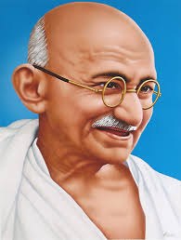
“A customer is the most important visitor on our premises. He is not dependent on us. We are dependent on him. He is not an interruption to our work. He is the purpose of it. He is not an outsider in our business. He is part of it. We are not doing him a favor by serving him. He is doing us a favor by giving us an opportunity to do so.”
- Mahatma Gandhi
Notes:
This quote is painted on the wall of an IEEE Human Resources conference room at the Operations Center in Piscataway, NJ.

Slide 2
Joint Region 5 and Region 3 Volunteer Call
Region 5 Member Engagement Webinar
Region 3 Section Support Forum
February 2019 – Where did all my members go?!

Slide 3
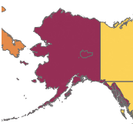
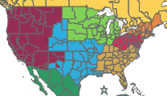
Welcome Region 3 Volunteers!
4
1
6
2
5
3
Notes:
The last Thursday of the month and first Friday of the following month are typically reserved for Region 5’s Member Engagement Call
For those who have participated on either a Region 3 or 5 call in the past, you may have noted Joe, Mark or Chris reference the collaboration that goes on between the Regions behind the scenes.
In a typical month one Region call is usually using the other Region call’s presentation with some minor changes.
For this month, we thought we’d try combining the calls.
Gives us a larger audience
Also provides you the volunteers to hear the perspective of other Regions’ Section leaders.

Slide 4
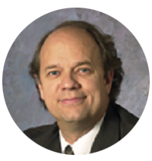
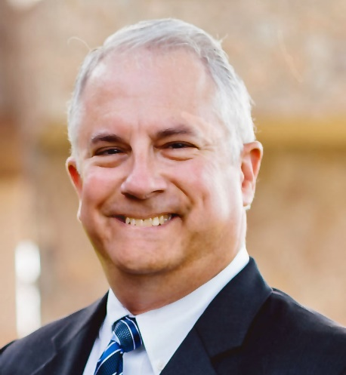
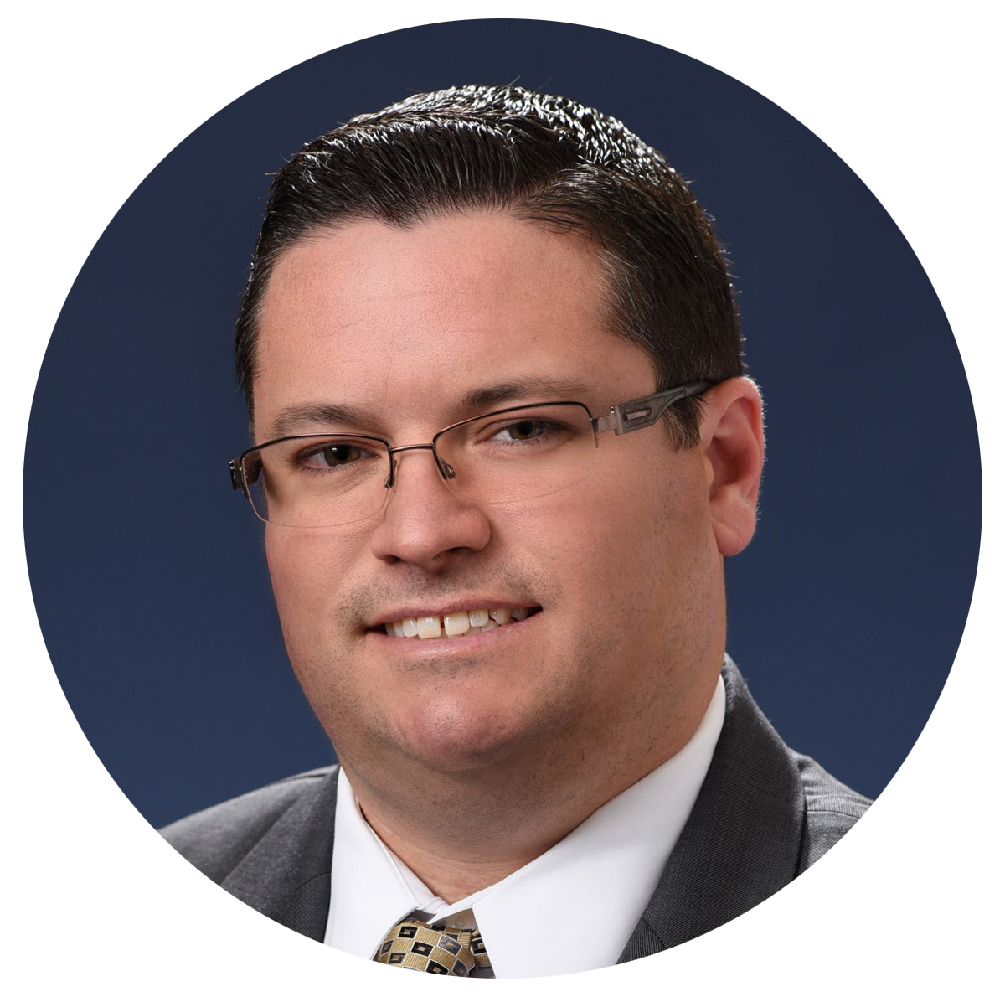
Agenda
Review the Membership Cycle Calendar
Where did all my members go?!
Women in Engineering
Open Discussion
Joe Redfield
R5 Membership Chair
Mark Torres
R3 Section Support Chair
Chris Wright
IEEE Staff Support

Slide 5
Where Did All My Members go?!

Slide 6
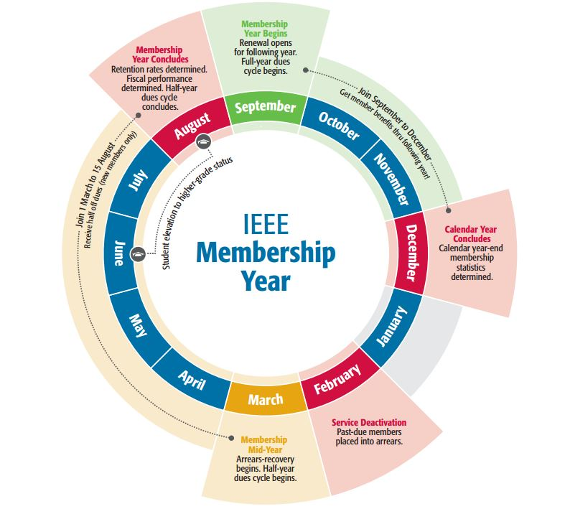
IEEE Membership Development Cycle
We’re Here
Notes:
For this month, we are going to take a deeper look at the Membership Development Cycle
It is important to keep this in the back of your mind when planning events, etc.
The Membership cycle for any given year starts on August 16th and runs through August 15th of the following year. So what does this mean.
We are currently in the 2019 Membership and have been for about 5 months.
The membership stats for goals setting, etc. are measured based on this calendar, not the actual membership year or volunteer term which all start on January 1
Think of it like a magazine subscription.
Most publishers send renewal reminders well advance of the last issue
Ensures continuity of service
IEEE staff have been busy working on membership renewal.
Mailing paper invoices
Multiple email campaigns
Any new members who joined on or after August 16th count towards 2019 recruitment.
Now that we are in calendar year 2019, Here’s what to expect moving forward:
From a calendar perspective:
We give our members a two month grace period to renew their membership before we shut of access to their benefits
To do this, IEEE staff run a process we call “Deactivation” toward the end of February. This year it will be 23-Feb-19.
We place any members who haven’t renewed in a status called “arrears”. Any arrears members from the previous year are made inactive giving them a break in service.
From a volunteer perspective:
Hopefully most of you have had the opportunity to transition into the role and learn from your predecessor
Continued planning and, more importantly, executing your plans,
If not, we suggest you connect as best you can with your predecessor
The info in this session should help you on board faster into your new role.

Slide 7
How are we doing?
Health Check for Region 5
* For membership statistics by Section, please refer to your Monthly Region Membership Development (MD) Report sent via email by your Region’s MD Chair and IEEE Staff Support person
Notes:
For this month, we’re going to take a look specifically at the Total Membership numbers for our Regions.
The stats shown represent where each region stands for the 2019 Membership Cycle (August 2018 through the end of January 2019)
They serve as an indicator of how well we are doing in delivering the Member Experience to our members
If you are not receiving your Region’s monthly report, please:
Run a search on your inbox to try and locate it.
Check your SPAM Folder. If the message is here, please mark it as spam and white list the email addresses of the sender(s).
If neither of these work, email your Region’s MD Chair and IEEE Staff Support person and request to be added to the recipient list

Slide 8
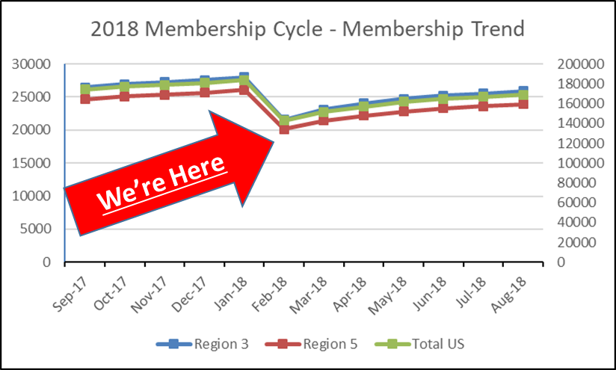
So where did all my members go?!
Service Deactivation
Notes:
Some may have no idea what we are referring to.
Those who frequently use OU Analytics may have noticed a significant drop in their total number of members between January and February.
The drop will be especially apparent in the February 2019 Membership reports
This is due to Service Deactivation
Deactivation is a standard IEEE process whereby any members who have not renewed their membership have their access to membership benefits turned off.
The process essentially switches the member’s record from Active to Arrears.
The first table compares the total number of members at month end for January 2019 and February 2019
The second graph shows the 2018 monthly membership cycle trend for Regions 3 &5 as well as total US.
Right now we’re at the bottom of the gully for the 2019 membership cycle.
IEEE staff sends a series of 4 generic email campaigns
This timing also presents an excellent opportunity to reach out to the deactivated members

Slide 9
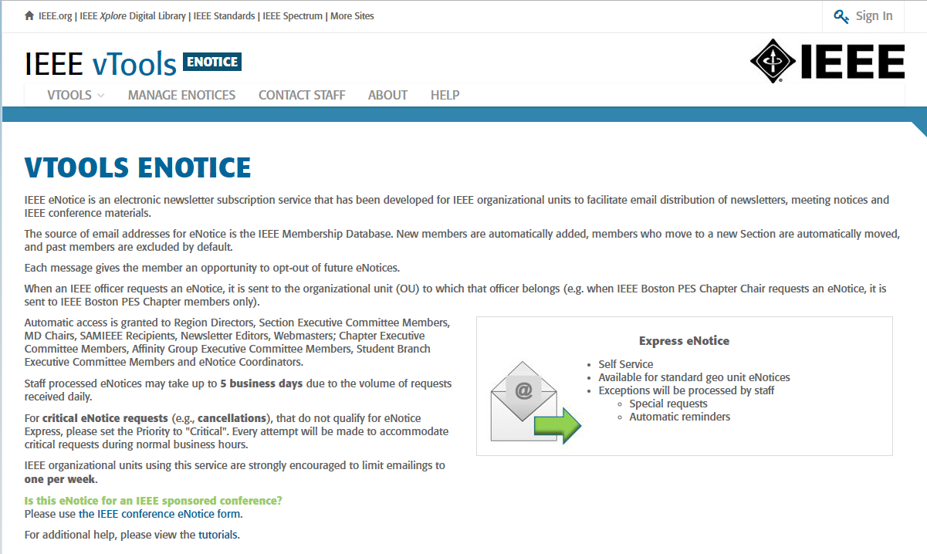
New Features of eNotice
https://enotice.vtools.ieee.org/
Notes:
For the Sections, eNotice has some new features
Better serve and communicate with your members
Also a good way to reach deactivated members as they are readily available
Why use eNotice?
eNotice express is fast, easy and you can send your message same day
Compliant with member communication preferences and GPR
New functionality
Personalization
Have the message come from you instead of the generic “IEEE eNotice”
Include the recipient’s name, member status and more
Attachments can now be added and sent as an Express message without staff intervention

Slide 10
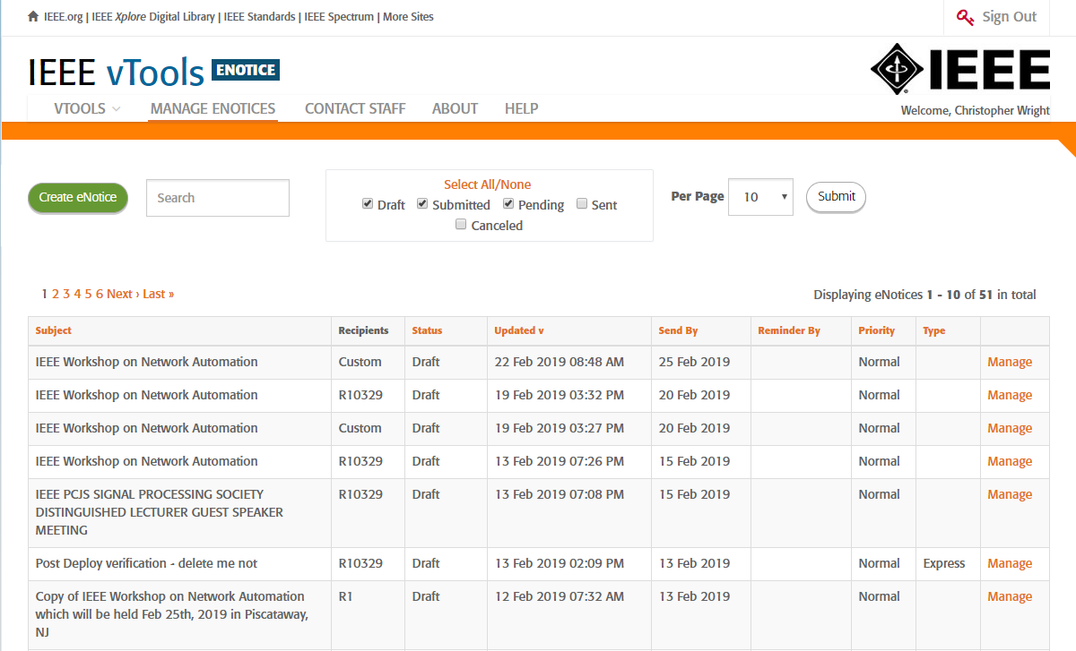
New Features of eNotice
https://enotice.vtools.ieee.org/
Notes:
You’ll see a list of all the eNotices created by your Section

Slide 11
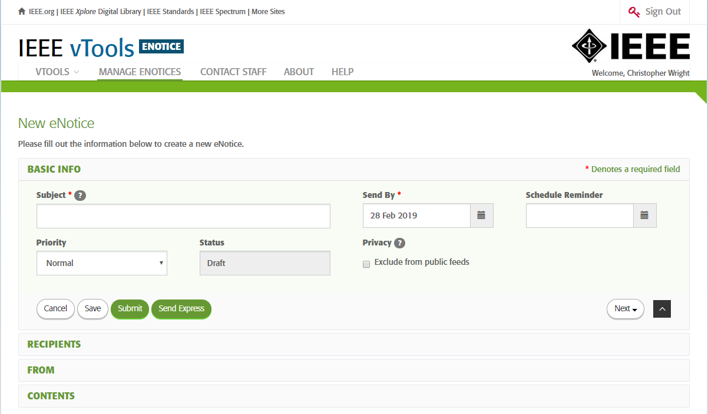
New Features of eNotice
https://enotice.vtools.ieee.org/
Notes:
Similar to the old platform most everyone is familiar with
Reorganized into four specific sections.
Each has a set of required fields

Slide 12
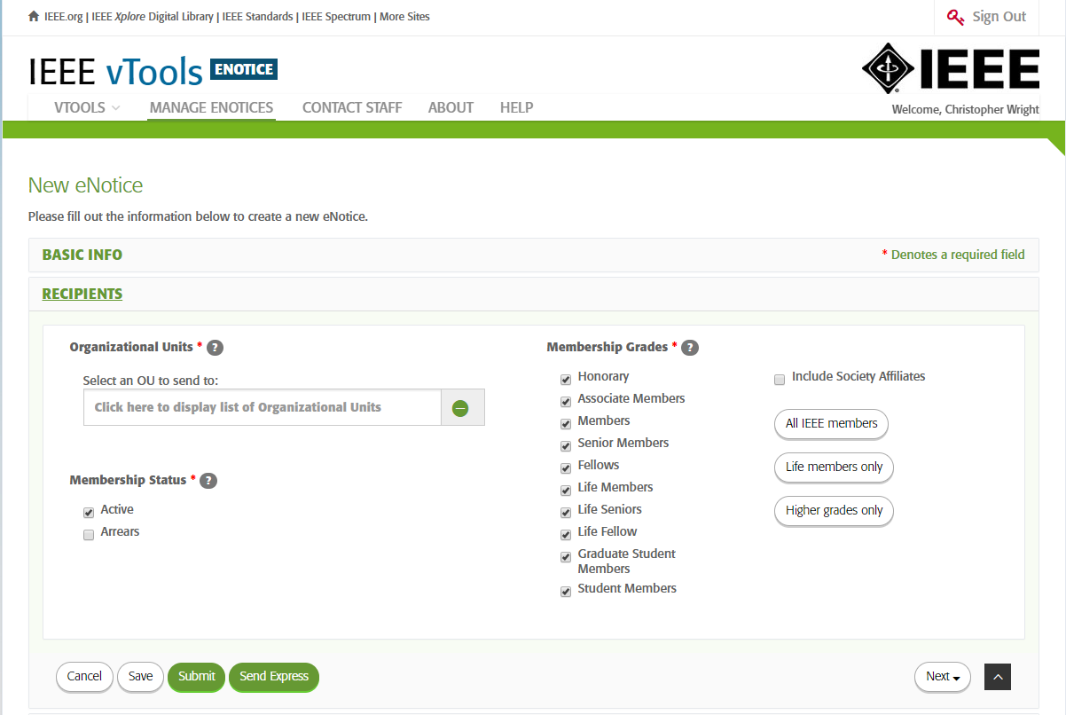
New Features of eNotice
https://enotice.vtools.ieee.org/

Slide 13
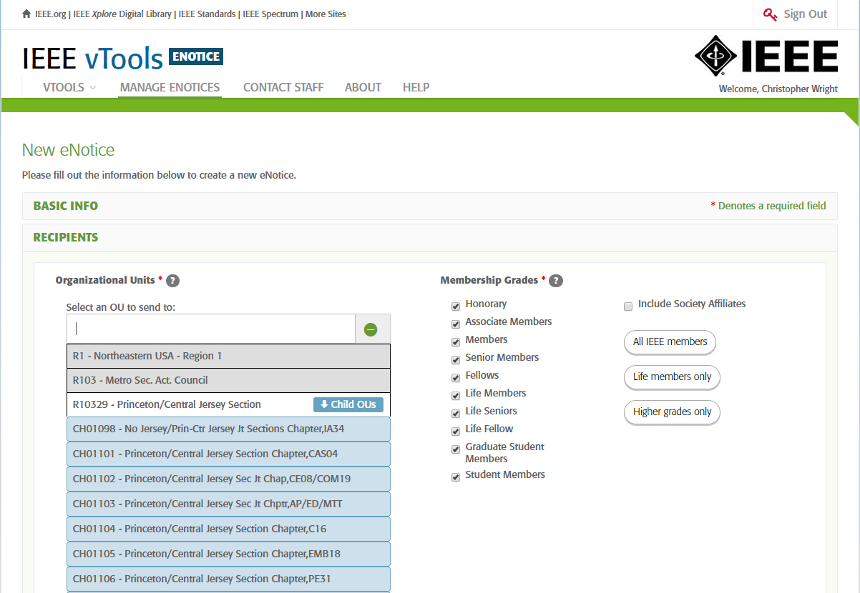
New Features of eNotice
https://enotice.vtools.ieee.org/
Notes:
Under the Organizational Unit, the user can further target their list from the entire Section down to the Chapters/Student Branches/Affinity groups, provided the Section has them officially set up with IEEE.

Slide 14
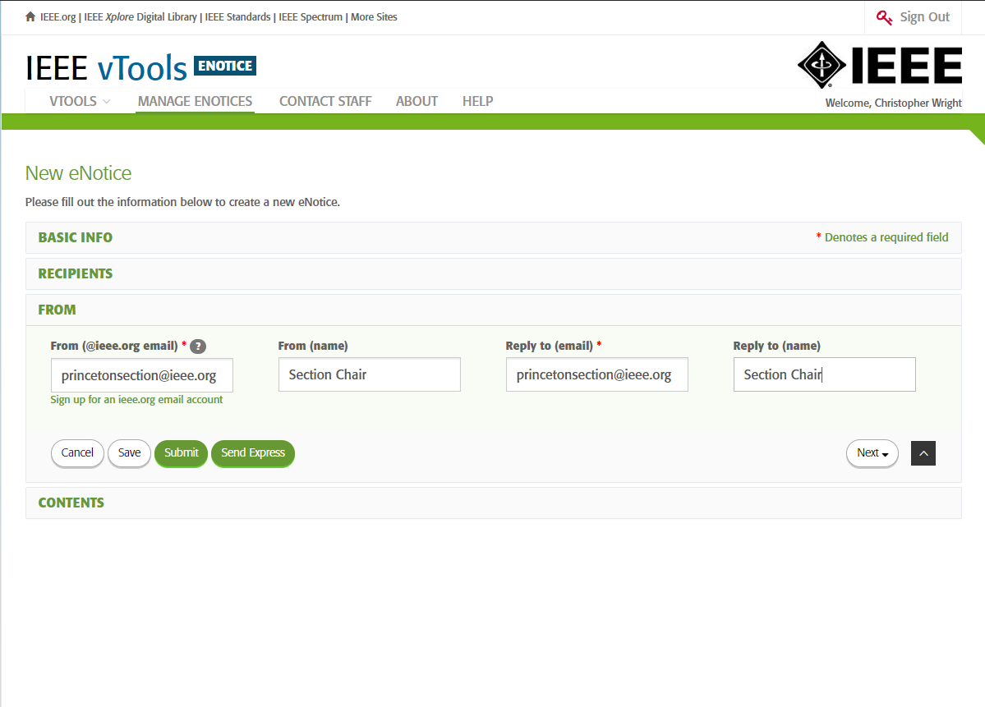
New Features of eNotice
https://enotice.vtools.ieee.org/
Notes:
You can personalize who the message comes from and where replies are sent to
For the “From” personalization, it must be set to an @ieee.org email address.

Slide 15
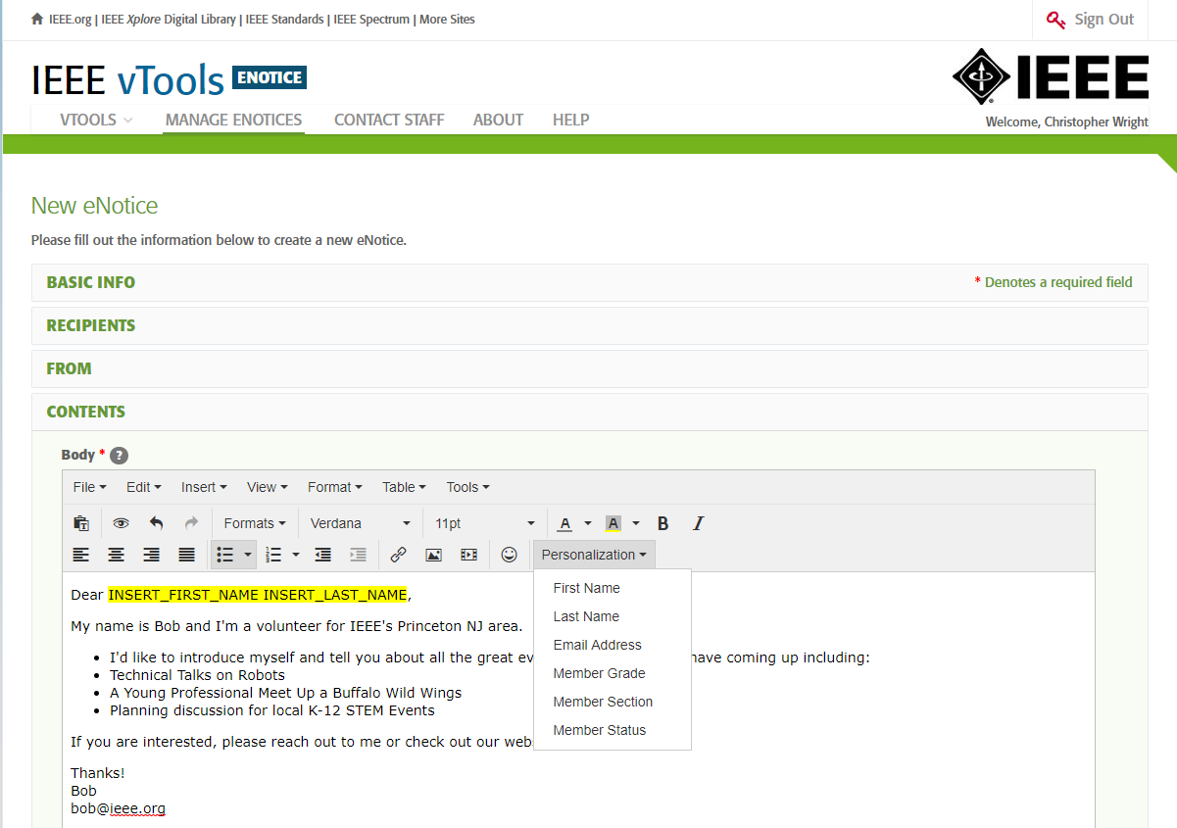
New Features of eNotice
https://enotice.vtools.ieee.org/
Notes:
Perhaps the biggest change is the ability to personalize the message directly to your members
Under the Personalization drop down there are 6 options
Simple click where you’d like to input the personalization field in the Body Section.
Then use your mouse pointer to open the Personalization dropdown and select the option
In this example you can see I added the members first and last name (highlighted in yellow)
On the back end:
eNotice pulls a list of members based on your previously selected recipient criteria
The system mail merges the personalization field data for each contact
It also takes care of the members’ communication preferences.
What do I say?
Start with a basic message
Introduce yourself maybe talk about the value you get from IEEE
Let them know what you have for upcoming events
For there use the base message to create a message for various audiences

Slide 16
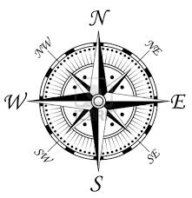
Moving Forward…
Checklist for the next month
Be on the look out for the next monthly Region Membership Report
Use eNotice to contact your members with a personalized message
For Women in Engineering:
  Have an AG? Send an eNotice promoting the next WIE event
  Don’t have an AG? Set up an organization session
  Contact your WIE Coordinator for assistance

Slide 17
Thank you! - Discussion
Joe Redfield Mark Torres Chris Wright
R5 MD Chair R3 SSC Chair IEEE Staff
210 744-2968 mgtorres@ieee.org 732 562-3894
j.redfield@ieee.org wright.c@ieee.org

Slide 18
Appendix

Slide 19
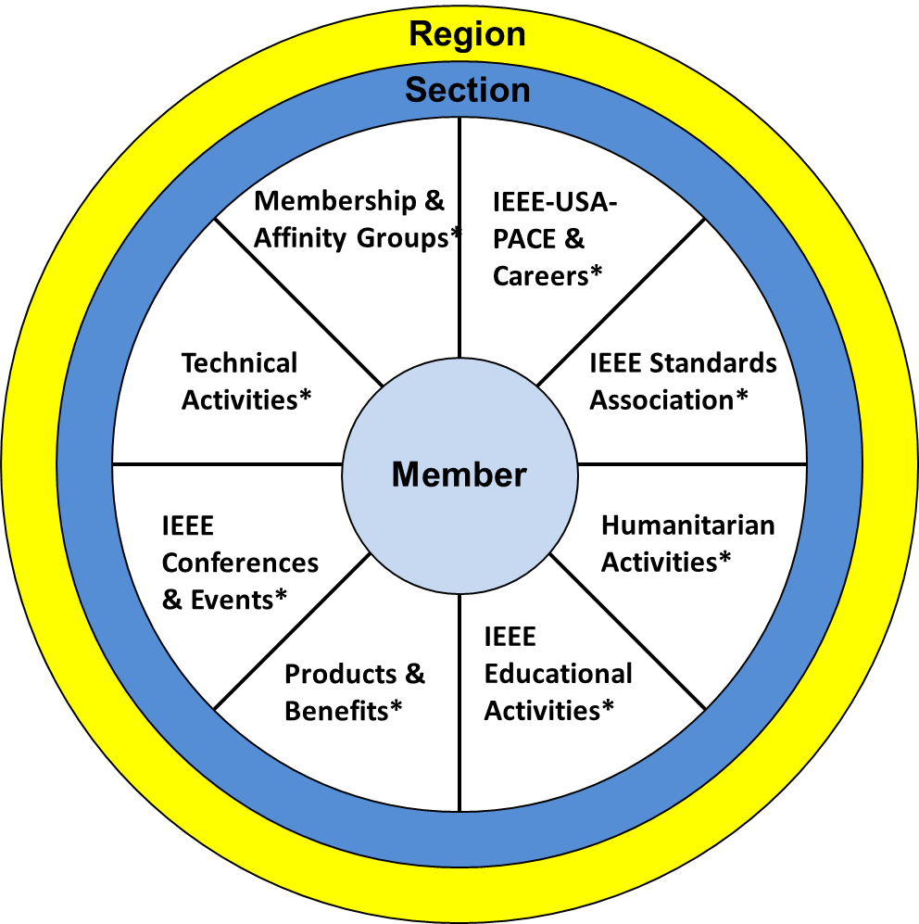
Member View of IEEE
IEEE is our members’ professional home
Notes:
As requested on the Thursday evening call…
Underwent an overhaul based on discussions with your fellow volunteers
We know:
This isn’t a perfect model
Some Groups operate outside of the Geographic Paradigm
But these are still happening locally
Not all Sections are the same, just like members.
What may work in one, won’t work in another

Slide 20
Region 5 Executive Committee
Committee Member Contact Information
Region Position | Name | Email
Regional Director | Bob Shapiro | bshapiro@ieee.org
Director Elect | Jim Look | lookjr@yahoo.com
Past Regional Director | Francis Grosz | f.b.grosz@ieee.org
Secretary | Edit Bourgeois | ejbourge@uno.edu
Treasurer | Paul Cassingham | pcassin@ieee.org
Membership Development | Joe Redfield | j.redfield@ieee.org
Area Chair – East | Matt Francis | mattfrancis@ieee.org
Area Chair – North | Mark Olive | markolive@ieee.org
Area Chair - West | Faye Kann | fkann@ecpcode.org
Area Chair - South | Christopher Sanderson | christopher.b.sanderson@ieee.org
Young Professionals | Amritesh Rai | amritesh557@ieee.org
Women in Engineering | Mehrube Mehrubeoglu | Ruby.Mehrubeoglu@ieee.org
Life Member Coordinator | Scott Atkinson | s.atkinson@ieee.org
Professional Activities | Nasr Ullah | nasr.ullah@ieee.org
Student Representative | Jessica Teeslink | jessica.teeslink@mines.sdsmt.edu
SAC-Representative | Tony Maciejewski | aam@colostate.edu
Educational Activities | David Pierce | d.pierce@ieee.org

Slide 21
Region 3 Section Support Committee
Committee Member Contact Information
Committee Position | Name | Email Address
Section Support Committee Chair | Mark Torres | mgtorres@ieee.org
Life Member Coordinator | Tom Bellarmine | gnanasigamani.bellar@famu.edu
Young Professional Coordinator | Danial Diaz | d.diaz@ieee.org
Women in Engineering Coordinator | Allison Mercer | Allison.Mercer@gtri.gatech.edu
Senior Member Elevation Coordinator | Jacquelyn Cunningham | jdnc@ieee.org
Sections Operations Specialists (Position 1) | Charles Lord | c.j.lord@ieee.org
Sections Operations Specialists (Position 2) | Bill Marshall | bill.marshall@gtri.gatech.edu
Project Coordinator | Grayson Randall | g.randall@ieee.org
Technical Activities Coordinator | Glenn Parker | Glenn.Parker@gtri.gatech.edu
Section Support Committee Mentor | William (Bill) Ratcliff | w.ratcliff@ieee.org
The IEEE Support Center is a great online resource.

Slide 22
Region 3 Section Support Committee
Support Team Contact Information
Support Team | Name | Email Address
Strategic Operations and Support | Dave Green | d.green@ieee.org
Member Activity Committee Chair | Sonya Dillard | sonya.dillard@ieee.org
Student Activities Coordinator | Victor Basantes | victor.basantes@ieee.org
Region 3 Director | Gregg Vaughn | g.vaughn@ieee.org
Region 3 Director Elect | Jill Gostin | Jill.Gostin@gtri.gatech.edu
Region 3 Past Director | Jim Conrad | jmconrad@uncc.edu
Region 3 PACE Chair | Teresa Brunasso | theresa.brunasso@gmail.com
IEEE HQ Region 3 Staff Contact | Chris Wright | wright.c@ieee.org
IEEE HQ Region 3 Staff Contact | Adrienne Hahn | a.hahn@ieee.org
IEEE HQ Young Professional Staff Coordinator | Kristen Mahan (YP) | k.mahan@ieee.org
IEEE HQ Women in Engineering Staff Coordinator | Paola Bringas (WIE) | p.bringas@ieee.org
The IEEE Support Center is a great online resource.

Slide 23
Important Section Resources
All the information you need to run your Section
IEEE Region 5 Website
Access Past Member Engagement Calls on Google Drive
IEEE Volunteer Rosters Page
IEEE vTools – volunteer tools to run your Section
  Tools Tutorials
  vTools Support
Important Operating Unit Websites – access resources designed for these groups
  IEEE Societies
  IEEE Students – New site coming soon
  IEEE Young Professionals
  IEEE Women in Engineering
  IEEE-USA – great resource for careers and advocacy
The IEEE Support Center is a great online resource.

Slide 24
Important Section Resources - continued
All the information you need to run your Section
IEEE Brand Experience
  Templates, Tools, and Resources
  IEEE Brand Videos
Resources to Strengthen Membership
  Membership Development Kit Online Portal – MD order your kit here
  Membership Resources page – access a number of presentations, tips etc.
  IEEE Experience Channel on IEEE.tv
  Member Experience Social Channels – Instagram, Facebook and Twitter

Slide 25
Important Section Resources - continued
All the information you need to run your Section
Links to Member Interest Resources
  Remain Technically Current
  IEEE Conferences & Events
    IEEE Meeting & Conferences Event Finder
    IEEE Events – find local events and activities
  Continuing Education
  Career Resources
  Humanitarian & Philanthropic Activities
  Discounts

